Slide 1

OpenStack Heat OS:: Cloud :: Orchestrator
Kanagaraj Manickam (kanagaraj.manickam@hp.com)
Sirushti Murugesan (sirushti.murugesan@hp.com)
Aug 8th 2015
OpenStack India Day @ Bangalore
© Copyright 2015 Hewlett-Packard Development Company, L.P. The information contained herein is subject to change without notice.
© Copyright 2015 Hewlett-Packard Development Company, L.P. The information contained herein is subject to change without notice.

Slide 2
Agenda
OpenStack & Cloud application
Heat
Introduction
HOT Template
Architecture
Heat Engine
Problems
Convergence
Blueprints & future
Q&A.

Slide 3
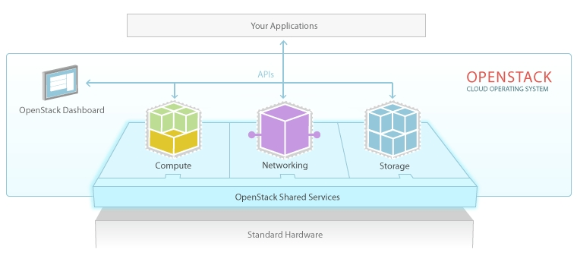
OpenStack
OpenStack = Cloud operating system
Platform for operator
To setup the cloud(s) on the datacenter(s).
Platform for user
To create and manage the life-cycle of
instances, volumes, networks, applications, etc.
Cloud Application
A stack consists of instances, volumes, networks, software, configuration, etc.

Slide 4



Cloud application
Sample Wordpress webapp
Load-balancer
Wordpress
Web-server
Wordpress
Web-server
Wordpress
Web-server
Highly available Db-server
Configuration
Block volume

Slide 5
OpenStack Heat
© Copyright 2015 Hewlett-Packard Development Company, L.P. The information contained herein is subject to change without notice.

Slide 6


Introduction
An orchestration service to create and manage the lifecycle of cloud application
How to define the cloud application (in YAML/JSON)?
Heat provides Template (HOT & CFN)
How to customize the cloud application
Heat provides Parameters
How to define the cloud application element such as instances, volumes ?
Heat provides Resource
How to create and manage the cloud application using template?
Heat provides Stack
How to manage the cloud application scalability?
Heat provides Auto-scaling
How to deploy the software in cloud application?
Heat provides Software-Deployment
How to configure the software in cloud application?
Heat provides Software-Configuration
How to track the progress of life-cycle operations ?
Heat provides Events

Slide 7

HOT Template and resources
Capture the declarative model of stack
my_instance:
type: OS::Nova::Server
properties:
key_name: kp1
image: cirros-0.3.3
flavor: m1.small
networks: [private]
heat_template_version: 2015-04-15
description: >
Cirros instance created with 10 GB volume
parameters:
key_name:
type: string
description: Name of an existing key pair for instance
constraints:
- custom_constraint: nova.keypair
description: Must name a public key (pair) known to Nova
flavor:
image:
network:
vol_size:
resources:
my_instance:
….
my_vol:
….
vol_att:
….
outputs:
instance_networks:
description: The IP addresses of the deployed instance
value: { get_attr: [my_instance, networks] }
my_vol:
type: OS::Cinder::Volume
properties:
size: 10 GB
/dev/vdb
10 GB
vol_att:
type: OS::Cinder::VolumeAttachment
properties:
instance_uuid: { get_resource: my_instance }
volume_id: { get_resource: my_vol }
mountpoint: /dev/vdb

Slide 8
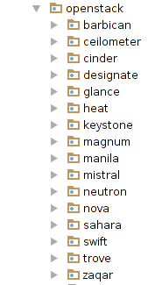
Resource
Connector between heat and other OpenStack services
Integrates the OpenStack services with heat for orchestrating their elements as part heat stack.
Identified by namespace Cloud Provider :: Service :: Resource
Examples: OS::Nova::Server, OS::Cinder::Volume
Supports following Life-cycle operations
Create / Update / Delete
Snapshot / restore
Abandon / adopt

Slide 9

Architecture
Heat-engine
Heat-engine
Heat-engine
nova
CFN / HOT Template
Heat-engine
Heat-api
cinder
RPC message bus
neutron
Heat Db
….

Slide 10
Heat-Engine
© Copyright 2015 Hewlett-Packard Development Company, L.P. The information contained herein is subject to change without notice.

Slide 11
Problems in heat-engine
Capacity is a bottle-neck:
when exceeds engines RAM and CPU threshold
Reliability is compromised:
Engine fails, then stack is FAILED, but user can't recover engine failure, suppose operators.
Concurrent-update is not available
Once stack is locked by a heat-engine, it unlocks only after stack is provisioned. User end-up in waiting, till stack completes.
Stack is not in sync with reality.
Disk failure.
Network connection is down.
Etc.

Slide 12
Solution: Re-write Heat-Engine
© Copyright 2015 Hewlett-Packard Development Company, L.P. The information contained herein is subject to change without notice.

Slide 13



Persist progress into database
Track progress of resources and persist a graph.
Resumable Stacks.
Atomic operations to the database.
Graph of Heat Stack
Heat-engine

Slide 14
Async. cast of tasks
Heat-engine
Granularity at Resource level.
Load-balanced by RabbitMQ.
Separate workers.
RPC casts than calls.
Resources propagate on their own.
Worker
Heat-engine
Worker

Slide 15
So, problem & solution
Capacity is a bottle-neck:
when exceeds engines RAM and CPU threshold
Reliability is compromised:
Engine fails, then stack is FAILED, but user can't recover engine failure, suppose operators.
Concurrent-update is not available
Once stack is locked by a heat-engine, it unlocks only after stack is provisioned. User end-up in waiting, till stack completes.
Stack is not in sync with reality.
Disk failure.
Network connection is down.
Etc.
Convergence heat-engine:
Concurrent update
Stack lock is removed (and resource level lock is used), helps concurrent updates
Stack reliability:
When one engine fails, in-progress stacks are taken care by other engines automatically
Capacity:
Provisioning larger stack became the reality.
Continuous observer
Being designed to take care of the underlying cloud infrastructure failures.

Slide 16
Convergence Blueprints
A journey from Juno->Kilo->Liberty
Activity | Release | Owners
https://blueprints.launchpad.net/heat/+spec/convergence | Juno | Clint Byrum
https://blueprints.launchpad.net/heat/+spec/convergence-engine | Juno | Clint Byrum
https://blueprints.launchpad.net/heat/+spec/convergence-continuous-observer | Juno | Clint Byrum
https://blueprints.launchpad.net/heat/+spec/convergence-observer | Juno | Clint Byrum
Convergence-engine PoC on top of upstream heat codebase | Juno, Kilo | Anant Patil, Rakesh HS, Sirushti Murugesan, Ishant Tyahi, Unmesh Gurjar, Vishnusaran Murugan, Kanagaraj Manickam
Convergence-engine PoC | Kilo | Zane Bitter
Convergence-engine blueprint is converted into small blueprints based on above PoC | Kilo | Zane Bitter
https://blueprints.launchpad.net/heat/+spec/convergence-config-option | Kilo | Peter Razumovsky
https://blueprints.launchpad.net/heat/+spec/convergence-resource-table | Kilo | Sergey Kraynev
https://blueprints.launchpad.net/heat/+spec/convergence-message-bus | Kilo | Kanagaraj Manickam
https://blueprints.launchpad.net/heat/+spec/convergence-push-data | Kilo | Sergey Kraynev
https://blueprints.launchpad.net/heat/+spec/convergence-stack-data | Kilo | Anant Patil
https://blueprints.launchpad.net/heat/+spec/convergence-concurrent-workflow | Liberty | Angus Salkeld
https://blueprints.launchpad.net/heat/+spec/convergence-graph-progress | Liberty | Rakesh H S
https://blueprints.launchpad.net/heat/+spec/convergence-lightweight-stack | Liberty | Sirushti Murugesan
https://blueprints.launchpad.net/heat/+spec/convergence-prepare-traversal | Liberty | Rakesh H S
https://blueprints.launchpad.net/heat/+spec/convergence-check-workflow | Liberty | Sirushti Murugesan
https://blueprints.launchpad.net/heat/+spec/convergence-resource-locking | Liberty | Ishant Tyagi
https://blueprints.launchpad.net/heat/+spec/convergence-rollback | Liberty | Anant Patil
https://blueprints.launchpad.net/heat/+spec/convergence-resource-replacement | Liberty | Angus Salkeld
https://blueprints.launchpad.net/heat/+spec/convergence-resource-operations | Liberty | Kanagaraj Manickam
Enable Convergence-engine-functional testing in zuul gate | Liberty | Heat Community
Convergence-engine Functional-testing and bug fixing | Liberty | Heat Community

Slide 17
Convergence Future
A journey from Liberty ->Mitaka
Activity | Release
Core logic is completed, and remaining work to be completed like Suspend, resume, timeout, etc | Liberty
Convergence-observer investigation, design and submit the blueprints | Liberty
Convergence-continuous-observer investigation, design and submit the blueprints | Liberty
Implement the convergence-observer | Mitaka
Implement the convergence-continuous-observer | Mitaka

Slide 18
Consumers
Actively uses heat for orchestration
OpenStack services
TipleO https://github.com/openstack/tripleo-heat-templates
Magnum https://github.com/openstack/magnum/tree/master/magnum/templates
Solum https://wiki.openstack.org/wiki/Solum
Sahara https://wiki.openstack.org/wiki/sahara
HP products
HDP http://www8.hp.com/us/en/cloud/helion-devplatform-overview.html
NFV http://www8.hp.com/in/en/cloud/nfv-overview.html

Slide 19
References
Knowledge base
Wiki: https://wiki.openstack.org/wiki/Heat
Template guide: http://docs.openstack.org/developer/heat/template_guide/hot_spec.html
Resource plugin guide: http://docs.openstack.org/developer/heat/pluginguide.html
Sample heat-templates: https://github.com/openstack/heat-templates
Developer guide: http://docs.openstack.org/developer/heat/

Slide 20
Thank you
Q & A
Sirushti Murugesan : @sirushti
Kanagaraj Manickam: @mrkanag
© Copyright 2015 Hewlett-Packard Development Company, L.P. The information contained herein is subject to change without notice.

